Slide 1
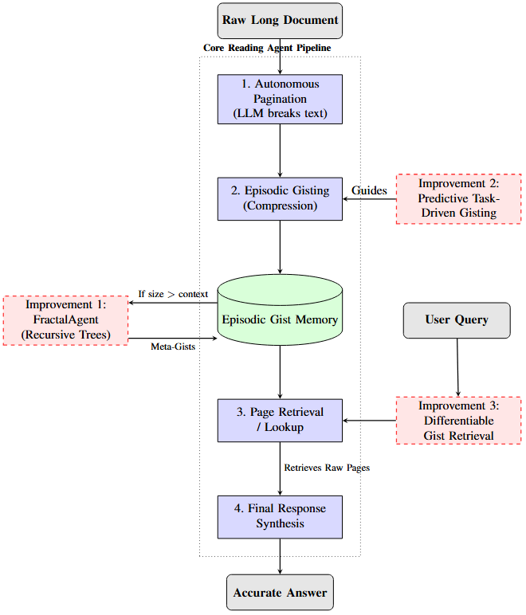
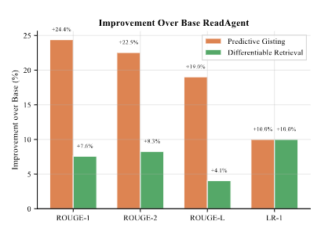
BEYOND EPISODIC MEMORY: ADDRESSING CONTEXTUAL AND COMPUTATIONAL LIMITATIONS OF READING AGENTS
Muhammad Qasim 22I-1994, Ayaan Khan 22I-2066, Abyaz Israr 22I-2056
Department of Artificial Intelligence and Data Science, FAST NUCES, Islamabad, Pakistan
ABSTRACT
SYSTEM ARCHITECTURE
EXPERIMENTS & METRICS
VISUAL FINDINGS
LLMs struggle with long contexts due to quadratic complexity. We present a holistic model addressing these via three innovations: FractalAgent for infinite context, Task-Driven Gisting for factual retention, and Differentiable Gist Retrieval for efficiency. Results show a 19.1% ROUGE-L increase and 84% latency decrease.
Workstation: RTX 3060 Ti, Mistral LLM API. Evaluated on NarrativeQA, QUALITY, and QMSum.
Metric | Improvement
ROUGE-L Score | +19.1% (Avg)
Retrieval Time | -84% (Avg)
Max Context | 35k+ Words
PROBLEM & MOTIVATION
Standard Transformers exhibit the "lost in the middle" problem. While episodic memory (ReadAgent) helps, it faces a "context wall" when concatenated gists exceed the LLM window.
Predictive gisting significantly reduces hallucination rates (LR-1 Strict Match: 83.3% vs 66.7%). Recursive trees compressed a 35k-word novel into 16 meta-gists (1,296 words).
The 4-step pipeline: Pagination (logic-based), Gisting (compression), Lookup (differentiable), and Synthesis (verbatim grounded).
LIMITATIONS & ETHICS
•
Hallucination: Compression inherently loses data; risk remains in medical/legal domains.
Bottlenecks:
•
Inference latency in interactive lookups.
Conclusion
•
Hallucinations in unconditional gisting.
•
Hard limits on document length.
METHODOLOGY IMPROVEMENTS
•
Environment: High token usage (200k for one novel) has tangible carbon footprints.
1. FractalAgent: Recursively summarizes gists into "meta-gists." Scaling is limited only by tree depth, enabling infinite context.
Our framework elevates reading agents from prompters to scalable AI systems. Future Work: Expanding to long-form video (WatchAgent) and dynamic branching factors for semantic density.
WHY AGENTIC AI?
•
Manage its own hierarchical memory.
2. Task-Driven Gisting: A forecasting agent establishment context/genre to preserve salient facts (names, numbers) relevant to predicted tasks.
•
Bias: Gisting may amplify model biases by selectively preserving perspectives.
•
Establish episodic boundaries autonomously.
CONCLUSION
•
Reason top-down through gist levels.
3. Differentiable Retrieval: Cosine similarity over dense vector embeddings.
•
Minimize costs through local tool use.

